Slide 1

What is an API?
“Application Program Interface”
Clearly defined methods of communication between various software components.

Slide 2
Two formats
XML – Extensible Markup Language
Ever wonder why Excel files went from xls to xlsx? The data is stored as XML.
JSON- Javascript Object Notation
Similar to R but used to make interactive objects in web browsers.
Respond in XML or JSON
Ask a question

Slide 3


Your phone doesn’t have every map in the world.
“Your phone requests information from the maps API services to render the information.

Slide 4
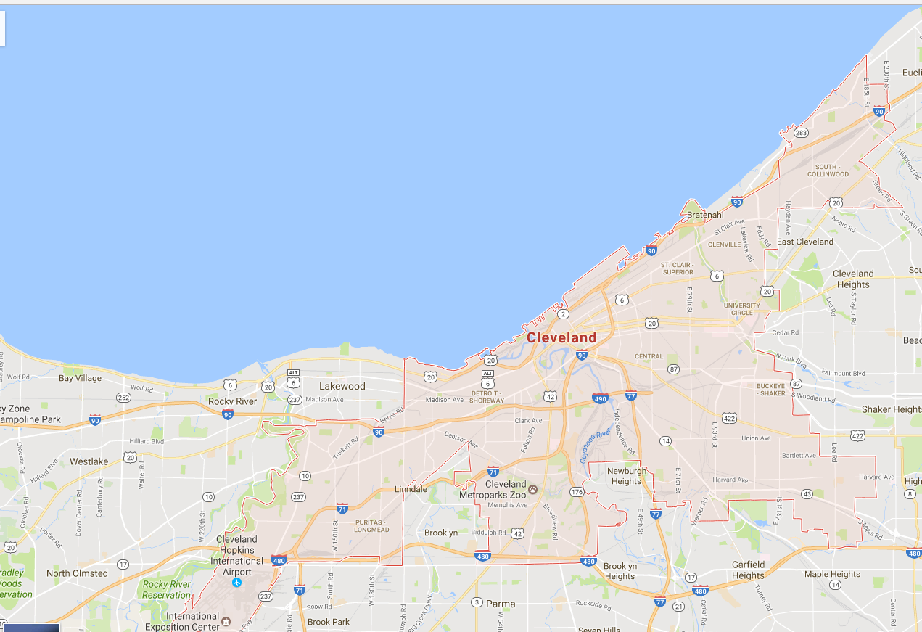
Your phone doesn’t have every map in the world.
www.google.com/maps/place/Cleveland,+OH/@41.4951143,-81.8462865,11z
Google Maps API Services include
Geocoding
Base map “tiles”
Basic Geographic Info

Slide 5
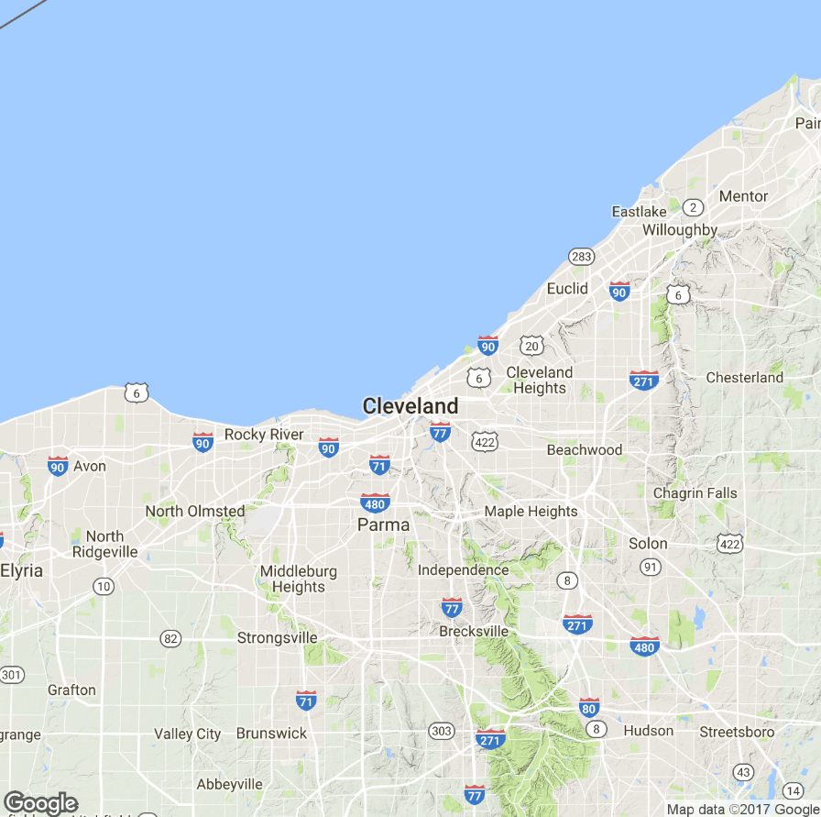
APIs are behind many of the sites you use everyday.
Static Map API
Static images are loaded as tiles underneath allowing you to scroll and navigate in your browser.

Slide 6
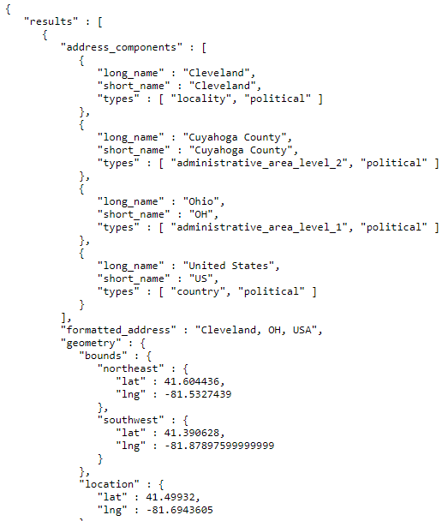
APIs are behind many of the sites you use everyday.
JSON Information API
On top of the tiles, more information is needed including the geo-political information and coordinates for the “bounding box”

Slide 7

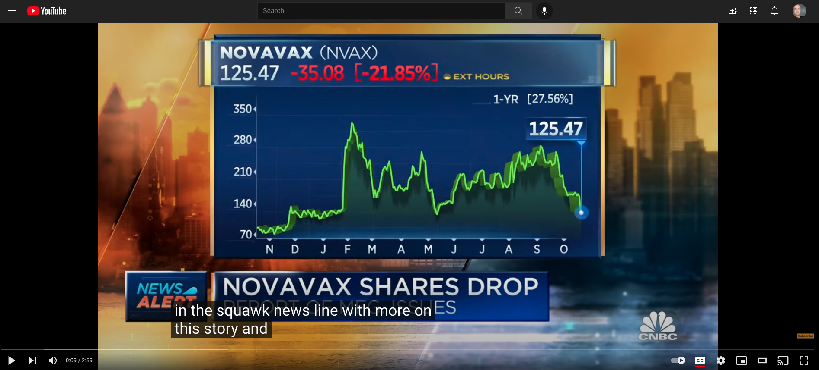
If you know where to look, you can access APIs for data!
If the video has closed captioning, let’s grab the text by clicking “cc”
https://www.youtube.com/watch?v=5F-o2_AC-Wo&ab_channel=CNBCTelevision

Slide 8

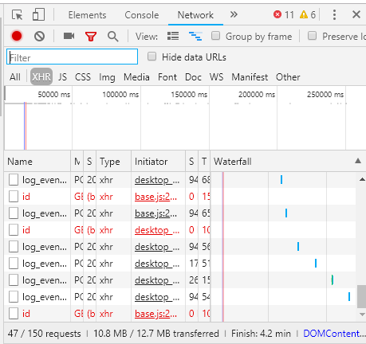
In chrome access the developer console.
While the video is playing, press F12 & reload the page.

Slide 9
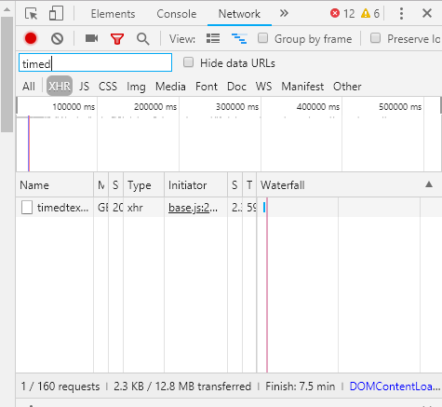
Click XHR and search for “timed” as in timedtext.
Right click on the request name and select “open in new tab”

Slide 10
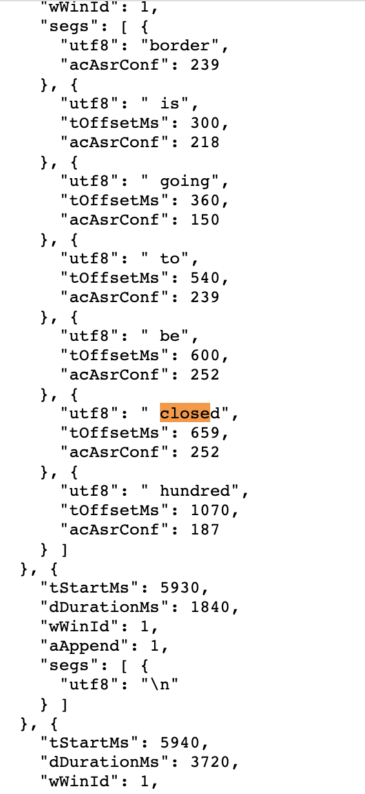
Closed Caption Data is in JSON

Slide 11
Let’s Practice…
A_youtubeAPI_example.R

Slide 12
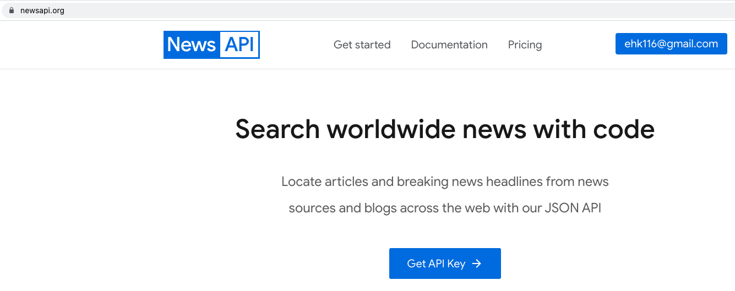
www.newsapi.org

Slide 13
PROS
Easy to understand documentation
Examples!
Free to try out
Search by query, time, language and news channel
128 News Sources
CONS
Rate limit
Only article snippets ☹

Slide 14
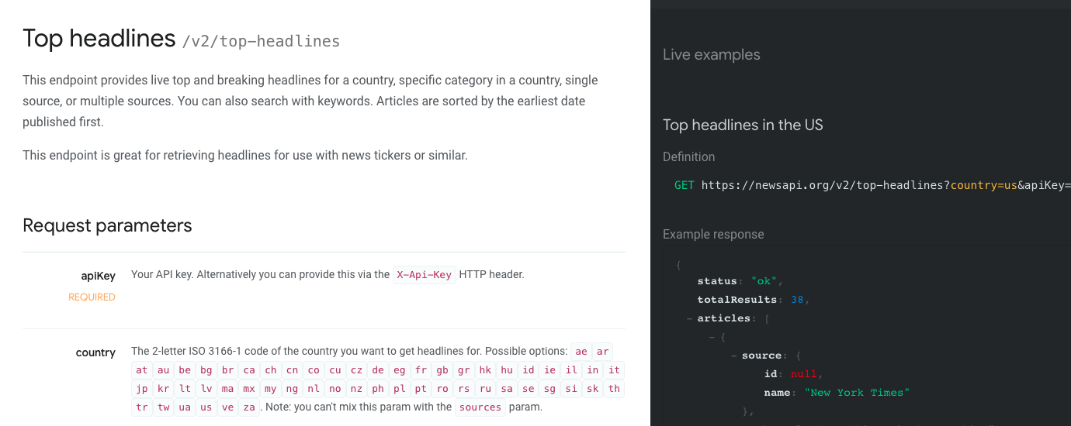
Example Documentation with parameters

Slide 15
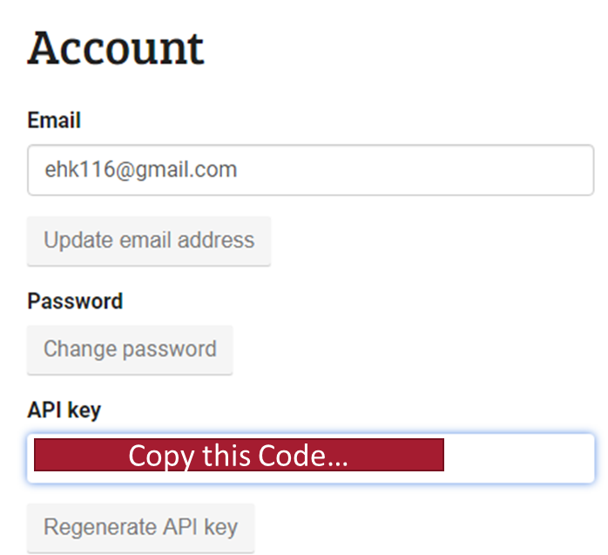

Some APIs require a “handshake” to authenticate

Slide 16
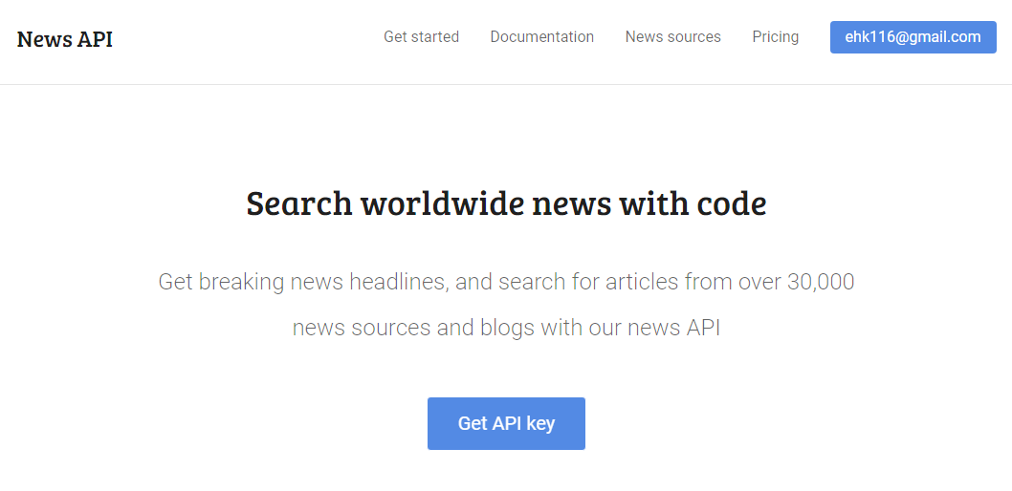
A Simple JSON API
Sign up at https://newsapi.org/

Slide 17

Now JSON
B_newsAPI_example.R

Slide 18
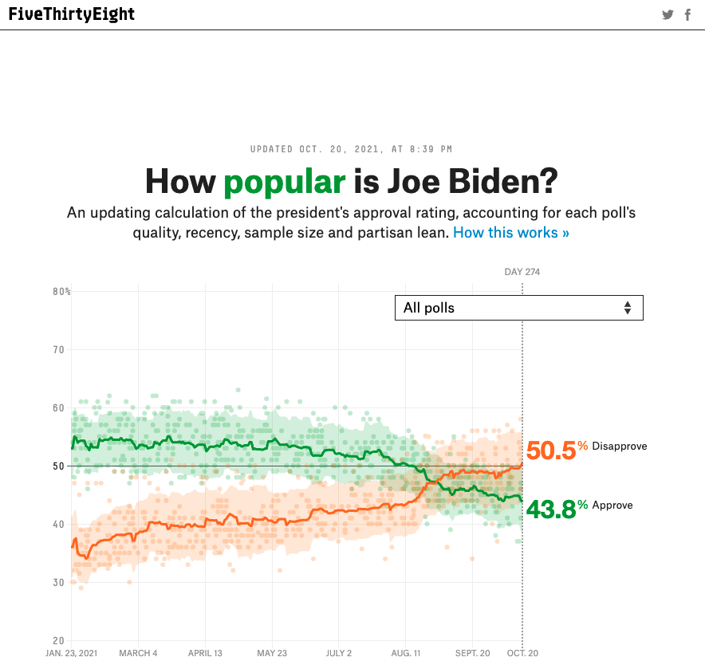
Web-scrape or API?
https://projects.fivethirtyeight.com/biden-approval-rating/
Doesn’t have to be text.
We can first look for an API before webscraping which is harder.

Slide 19
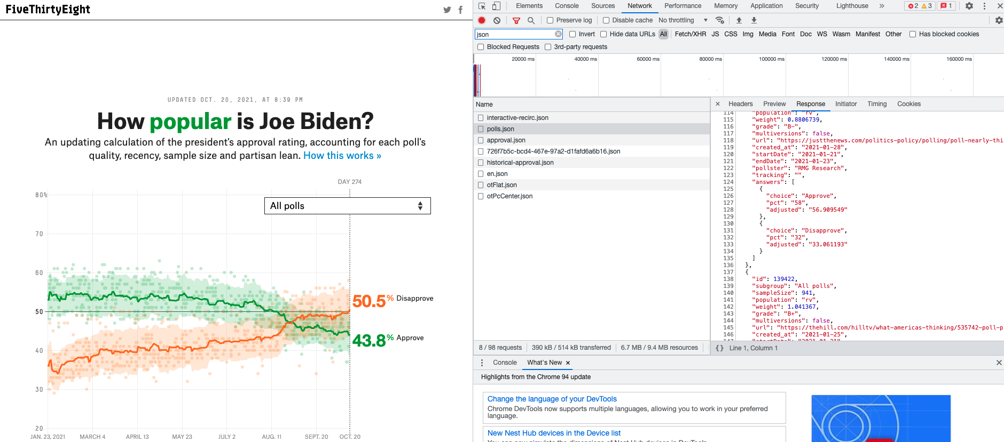
API! This should be much easier than web scraping!
Open C_presidentialApproval_scraping.R

Slide 20
Other Straightforward APIs to Explore
If you work with social media data (requires signing up)
https://pipl.com/dev/demo
Sources of APIs to explore
https://www.programmableweb.com/apis/directory
https://github.com/toddmotto/public-apis
Challenge find the APIs for the chart data here (hint: JSON using F12):
https://projects.fivethirtyeight.com/trump-approval-ratings

